Slide 1
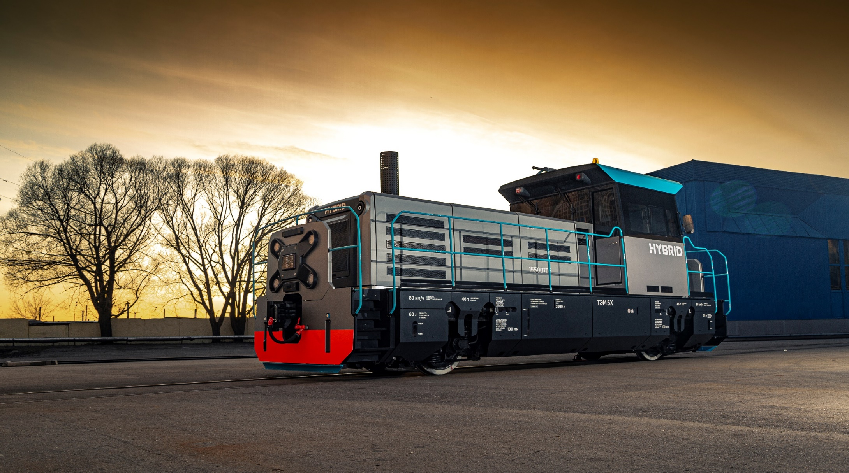

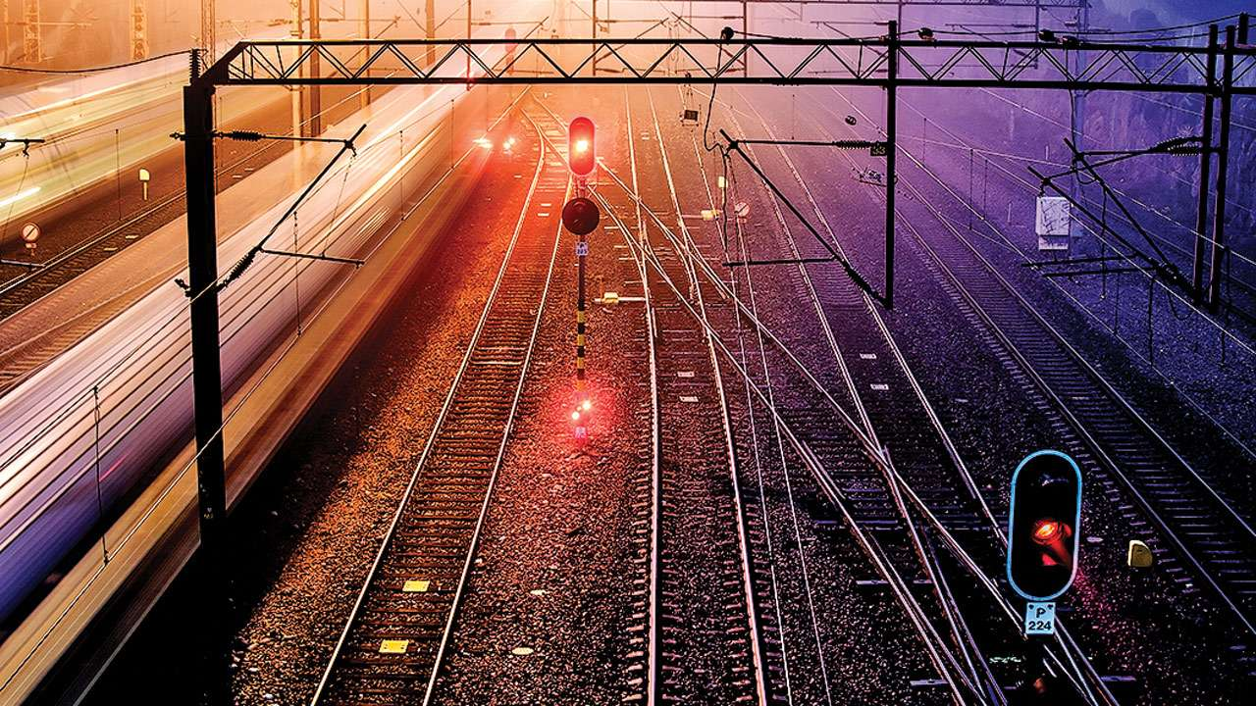
LocoTech-Signal
overview

Slide 2



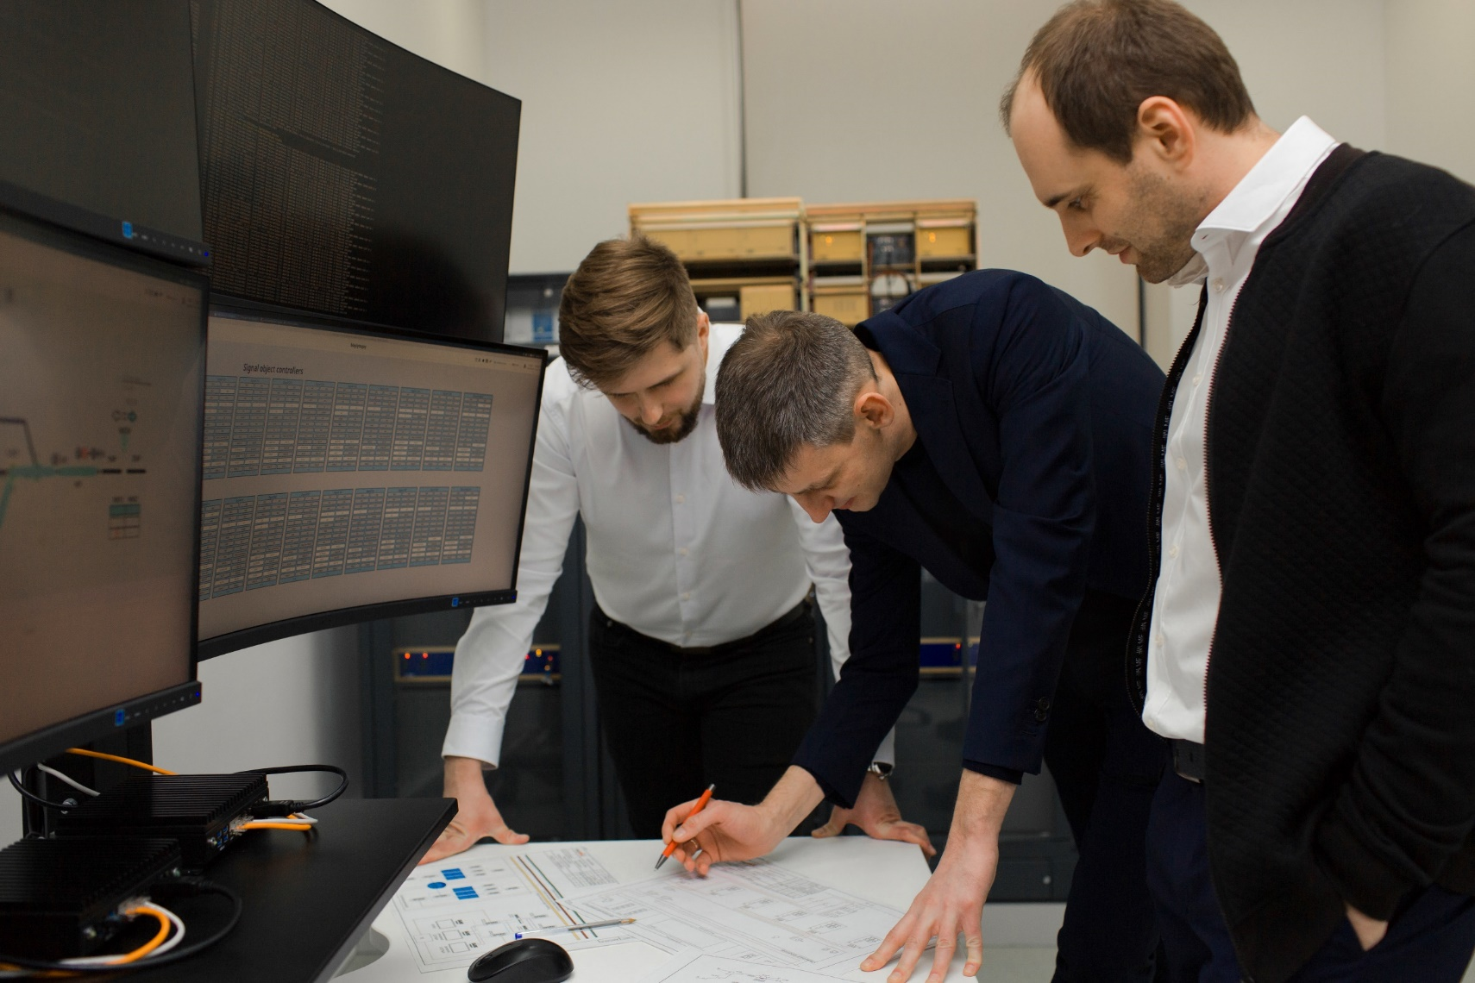



We are LocoTech-Signal
LocoTech-Signal –
Russian engineering group of companies focused on the creation of innovative solutions for modern signaling and traffic control systems
>125
>50
PEOPLE
PEOPLE
EMPLOYEES
ENGINEERS
221
5
5
MLN RUB.
COUNTRIES
COMPANIES
REVENUE*
MARKETS
ASSETS
* As of 2020
* in 2019

Slide 3



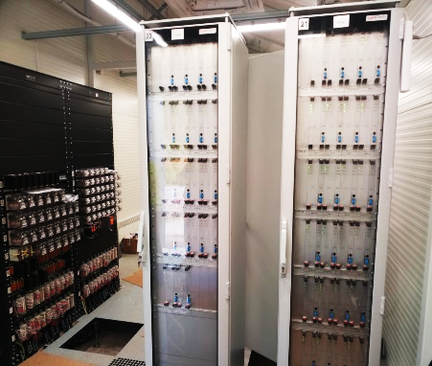
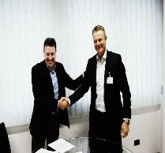
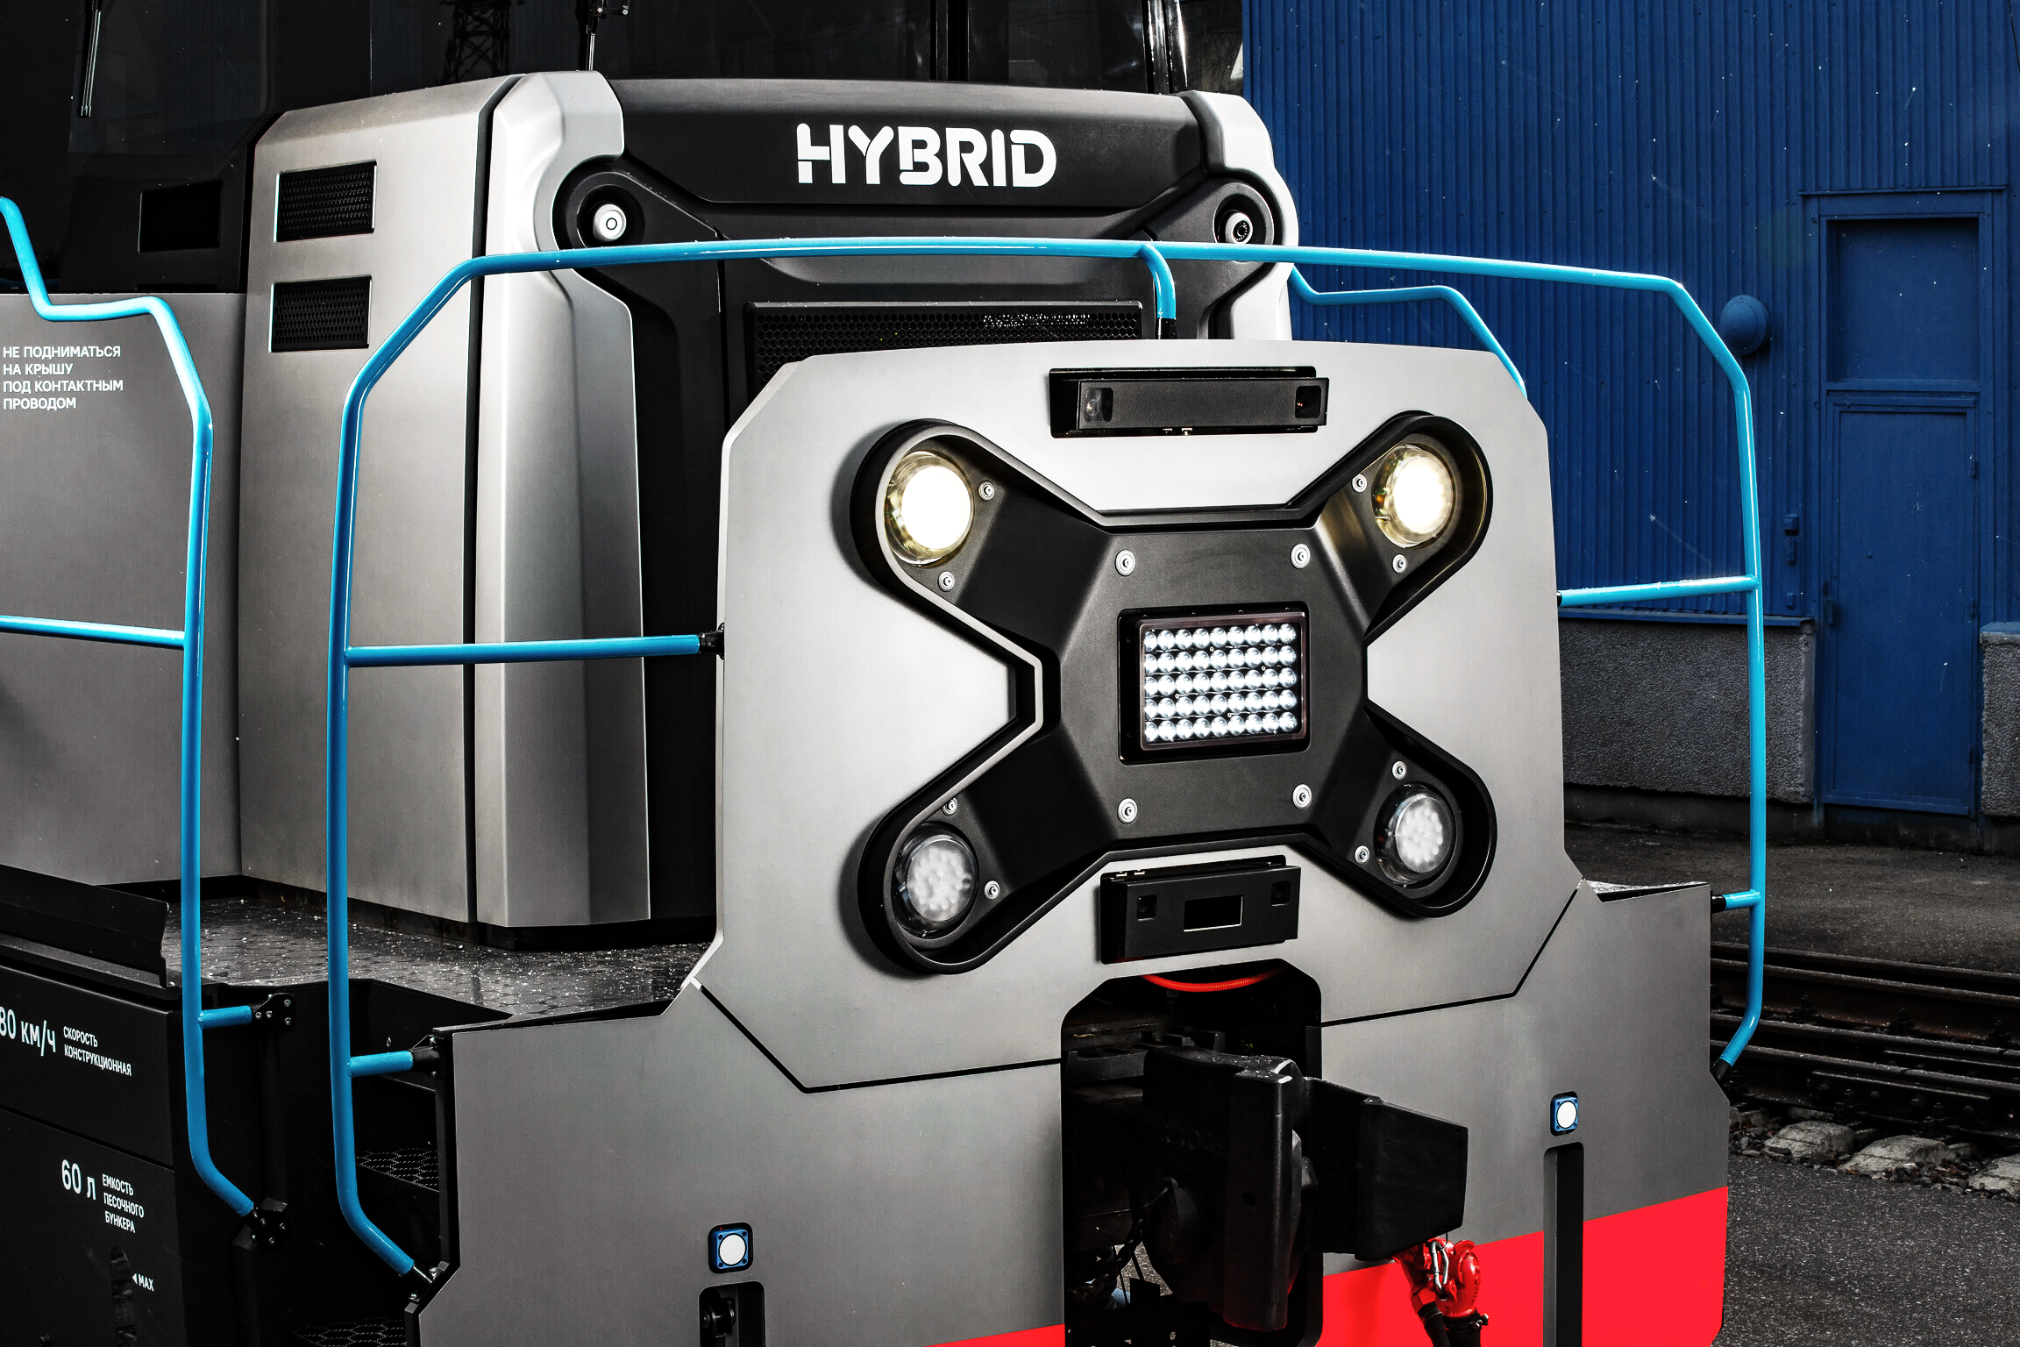

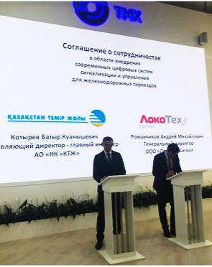
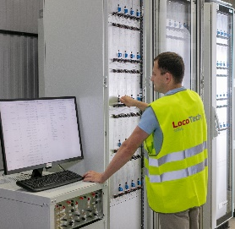
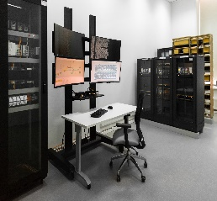
COMPANY MILESTONES
October 2017
October 2018
January 2019
January 2020
May 2020
Incorporation of
LocoTech-Signal
Ctrl@Lock200 TRCU certification
Estonia: Ctrl@Track100 supply contract
Agreement with ECM S.p.A. on introduction of electronic interlocking
Inauguration of the Machine Vision Competence Center
March 2018
November 2018
August 2019
April 2020
March 2021
Ctrl@Lock100 certification for metro implementation
Turkmenistan: supply contract of Level Crossing Signaling System
Cooperation Agreement
with KTZ on signaling
systems implementation
Latvia: Ctrl@Track100 supply contract
LocoTech-Signal and ECM S.p.A. open new research laboratory to adapt and test Ctrl@Lock400 powered by HMR9

Slide 4


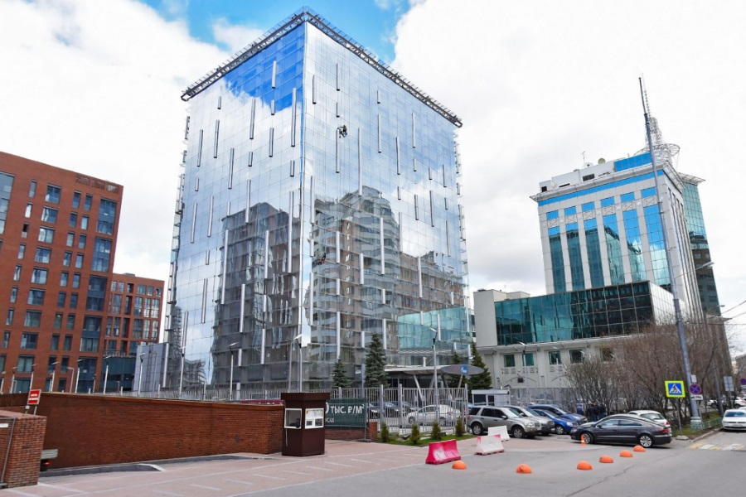


PART OF ONE BUSINESS ECOSYSTEM
LocoTech-Signal
part of the world's largest rolling stock manufacturer and service provider group - TRANSMASHHOLDING
Freight & Passenger rolling stock
ROLLING STOCK
Product Life Cycle Management
SERVICE
Digital Train Control Systems
TRAFFIC MANAGEMENT

Slide 5
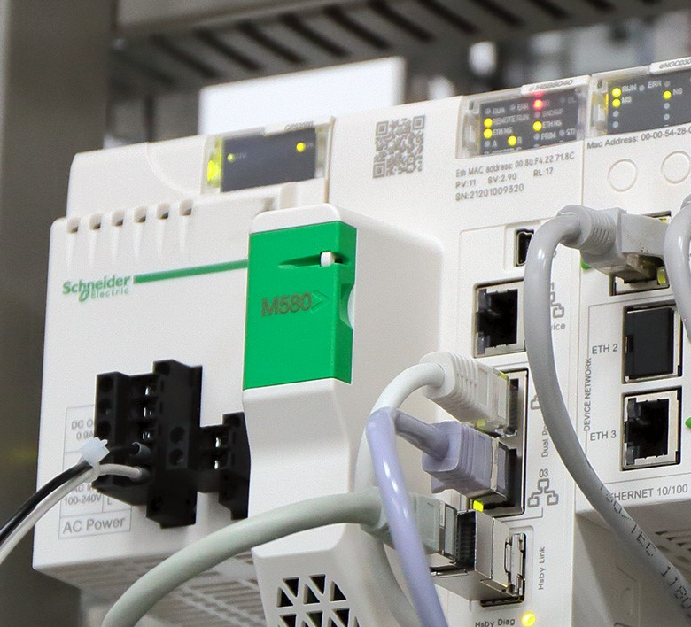
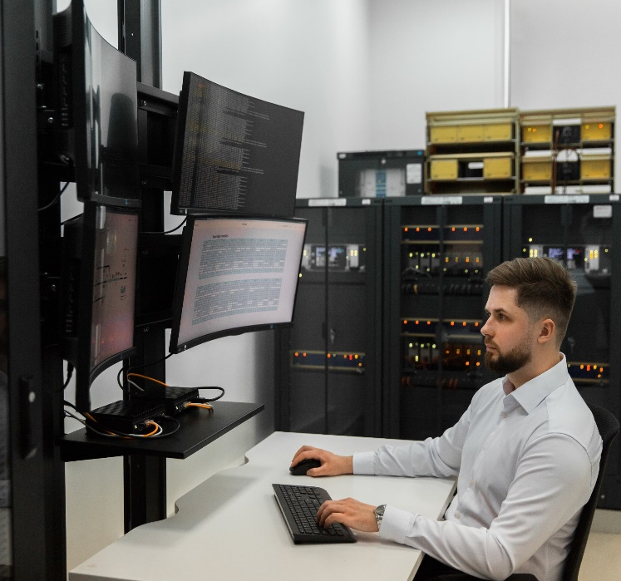
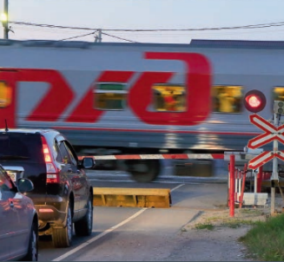
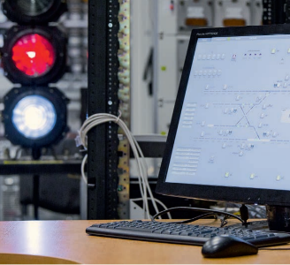
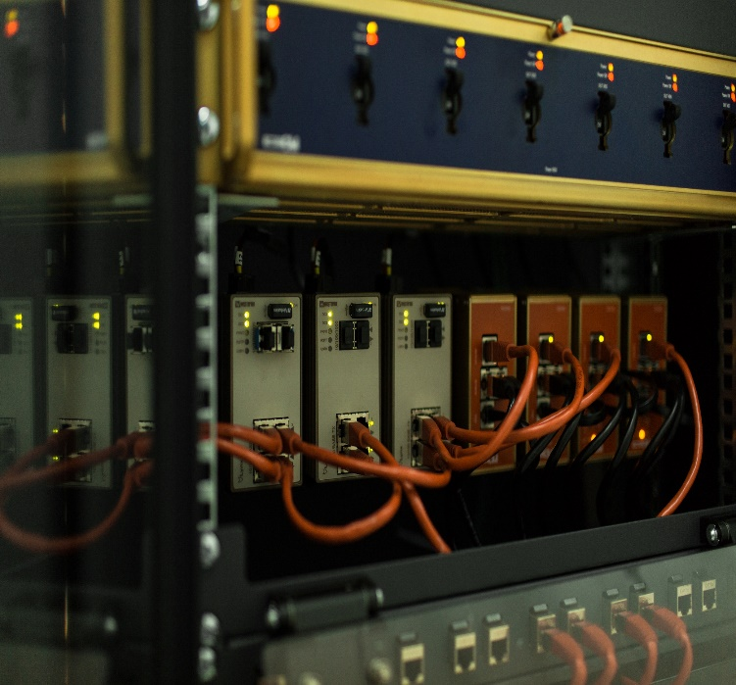
UNITED BY ONE MISSION
We create the safest and most effective traffic control solutions using advanced technologies

Slide 6
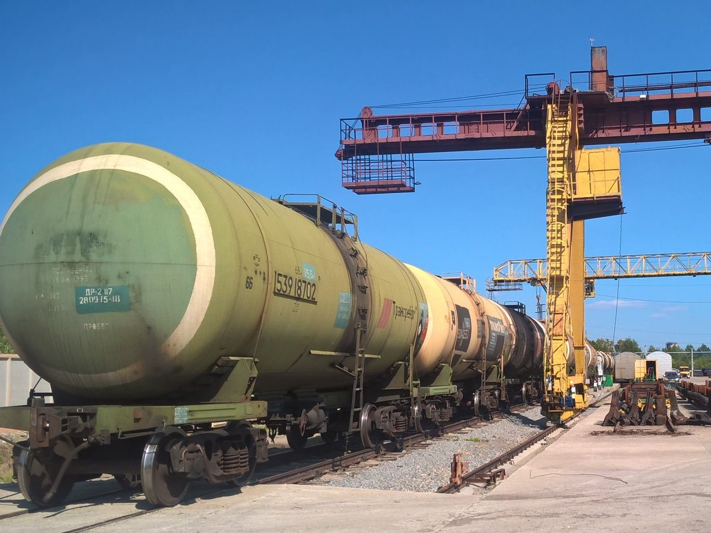
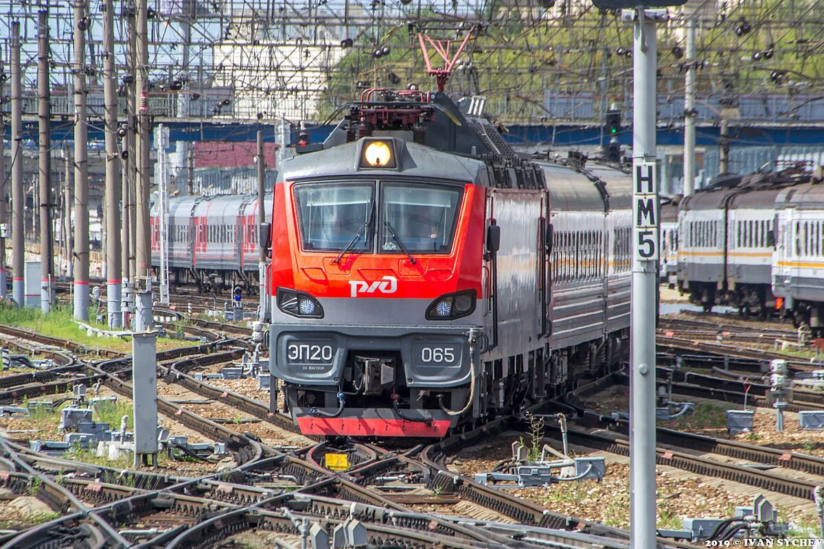
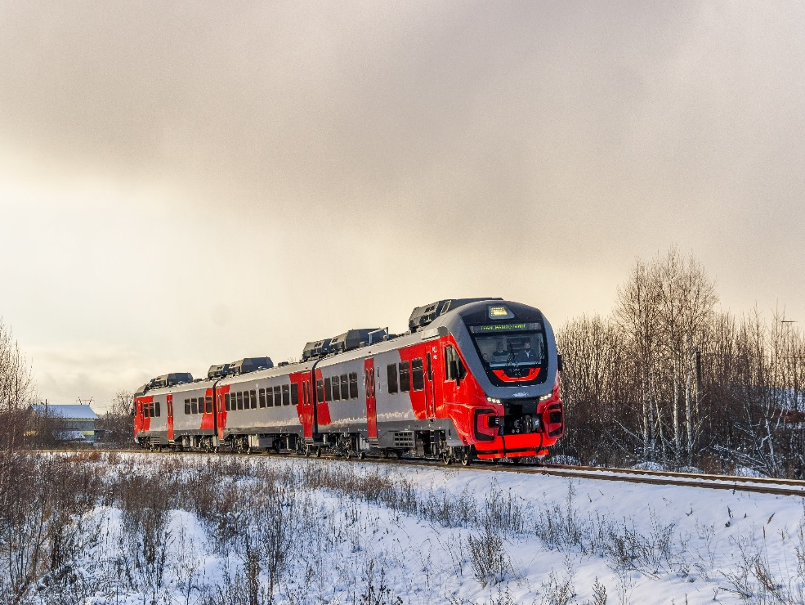
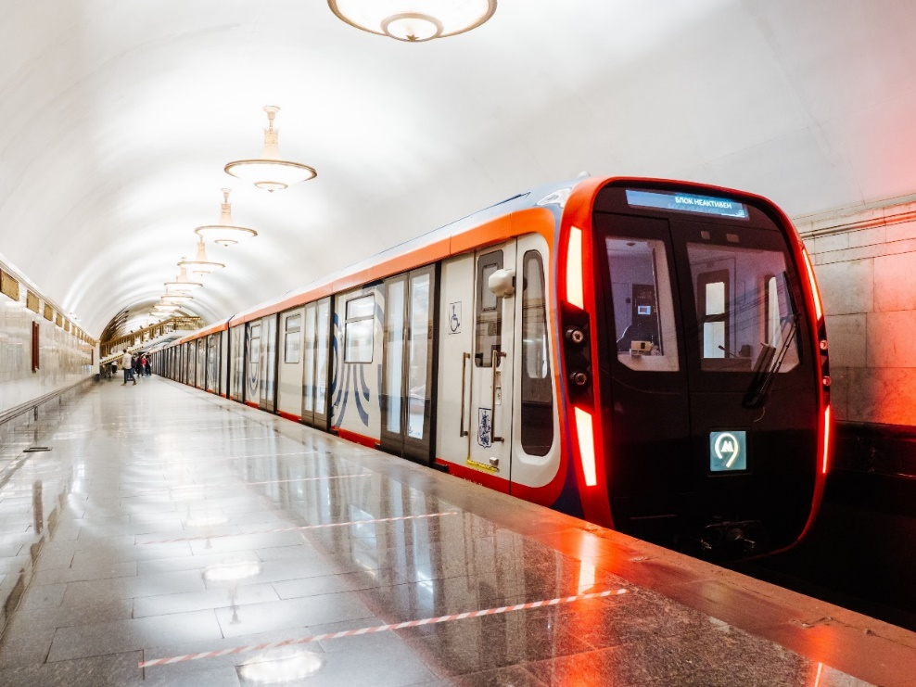
MARKETS WE SERVE
INDUSTRIAL
TRANSPORT
MAINLINE
TRANSPORT
COMMUTER
TRANSPORT
METRO
We work for all segments of rail transport

Slide 7
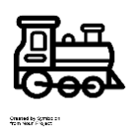

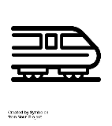












CLOSE TO CUTOMERS ALL OVER THE WORLD
RUSSIA
ESTONIA
INDUSTRIAL
TRANSPORT
MAINLINE
TRANSPORT
COMMUTER
TRANSPORT
METRO
LATVIA
UZBEKISTAN
KAZAKHSTAN

Slide 8








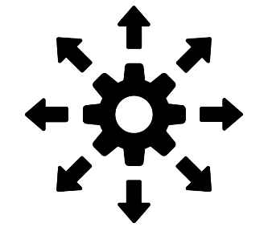
KEY PRODUCTS FOR INTEGRATED SOLUTIONS
CTRL@CONNECT
CTRL@VISION
CTRL@DRIVE
CTRL@SAFE
CTRL@DETECT
(virtual coupling)
(machine vision)
(ATO)
(ATP)
(predictive diagnostic)
CTRL@POINT
CTRL@TRACK
CTRL@LOCK
(wireless point control)
(track circuits)
(computer-based interlocking)
CTRL@TRAFFIC
(integrated solution)
- on-board systems
- Signaling systems
- Integrated solutions

Slide 9
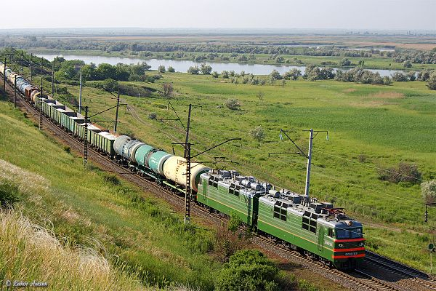

СTRL@CONNECT
Virtual coupling
control of multiple freight trains via radio channel
One driver controls 5 trains
(autopilot for «subordinated» trains)
Trains communicate via radio channel
Continuous data exchange between trains and infrastructure
KEY
FUNCTIONS
Growth of heavy-weight freight trains traffic
Up to 20% increase of rail network traffic capacity*
Growth of service speed
Decrease of infrastructure CAPEX
CUSTOMER
BENIFITS
APPLICATION
SCOPE
MAINLINE
TRANSPORT
* on the Karymska-Nakhodka section with a total length of more than 3 thousand km, the traffic capacity increased by 15 trains per day after equipping the system with 240 3ES5K locomotives (as of 2020))

Slide 10


СTRL@VISION
Rail traffic automation based on Machine vision technology
Objects and obstacles detection, collision pretension
Remote control
Automatic train control
Driver’s state and actions control
Accurate localization of the locomotive
KEY
FUNCTIONS
Railway operation and human safety improvement
Operation efficiency improvement
Step forward to autonomous train operation
CUSTOMER
BENIFITS
APPLICATION
SCOPE
INDUSTRIAL
TRANSPORT
URBAN TRANSPORT
(INCL. METRO)
MAINLINE
TRANSPORT
VARIOUS
INDUSTRIES

Slide 11
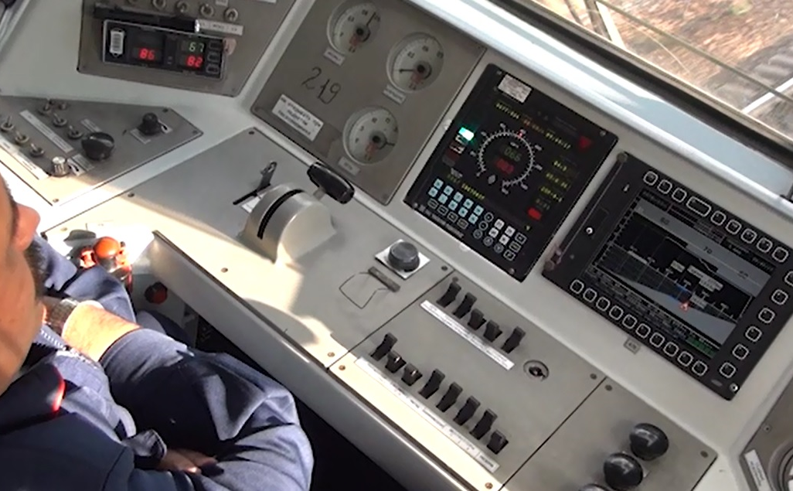

СTRL@DRIVE
Automatic train operation –
smart system to ensure automatic train operation in accordance with service conditions, traffic schedule, fuel and energy consumption rate
One-person locomotive driving
Automatic traction and braking control, incl. regenerative braking
Implementation of various traffic modes: according to the schedule, station-to-station driving time, in the advisor mode, using «virtual coupling» technology.
KEY
FUNCTIONS
Up to 8% decrease of fuel and energy consumption rate
Up to 1 min accuracy in traffic schedule compliance
Compliance with normal rolling stock operation conditions
CUSTOMER
BENIFITS
APPLICATION SCOPE
INDUSTRIAL
TRANSPORT
MAINLINE
TRANSPORT

Slide 12
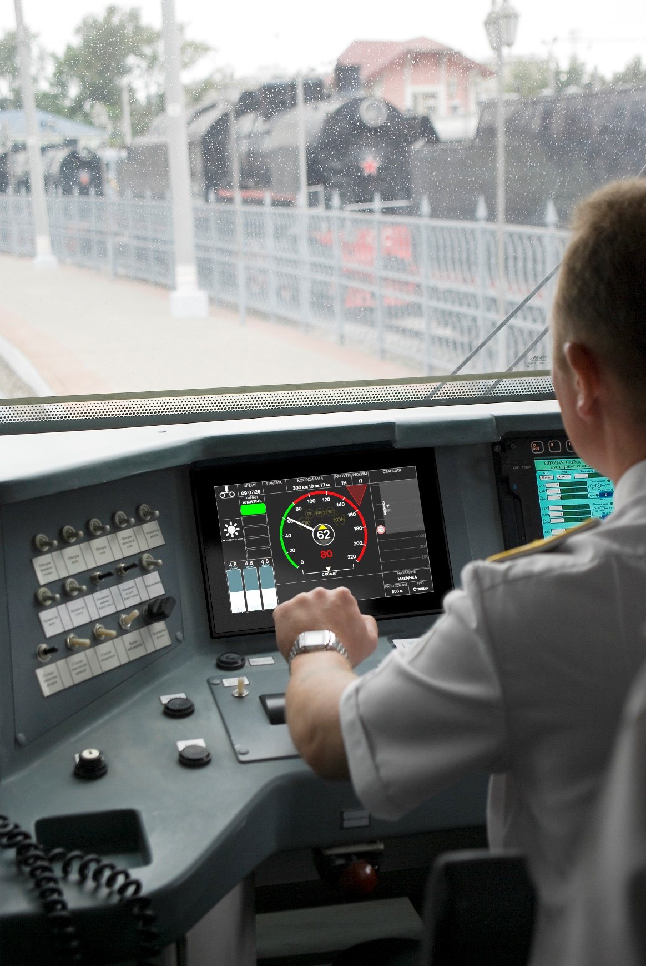
СTRL@SAFE
Automatic train protection –
system developed for locomotives of the Eastern Polygon of Russian Railways and new rolling stock
Key on-board equipment to ensure traffic safety
Integrated diagnostics of rail coils and track circuits
In-house decoding HMI
Cards converter from complex of locomotive safety devices
Touch control interface
KEY
FUNCTIONS
High reliability and fault tolerance
Portability
Scalability of functionality and ease of integration
CUSTOMER
BENIFITS
APPLICATION SCOPE
INDUSTRIAL
TRANSPORT
MAINLINE
TRANSPORT

Slide 13
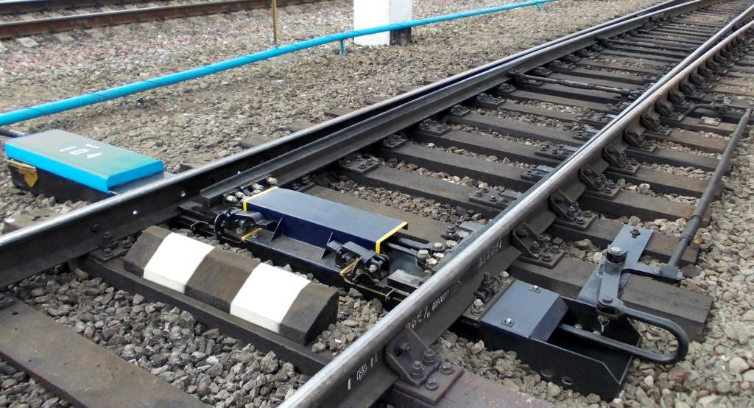
СTRL@POINT
Wireless point control
automated local point machine control system
Point control using radio channel-based tablet
Control of point switch position
Electrical and mechanical locking of the point in end positions
Exclusion of possibility to switch under the train
KEY
FUNCTIONS
  Possibility of one-person locomotive driving
  Minimizing time needed to switch the point or prepare the route
  Integration with automatic process control system
  Hardware manufacturer independency
CUSTOMER
BENIFITS
APPLICATION
SCOPE
INDUSTRIAL
TRANSPORT

Slide 14
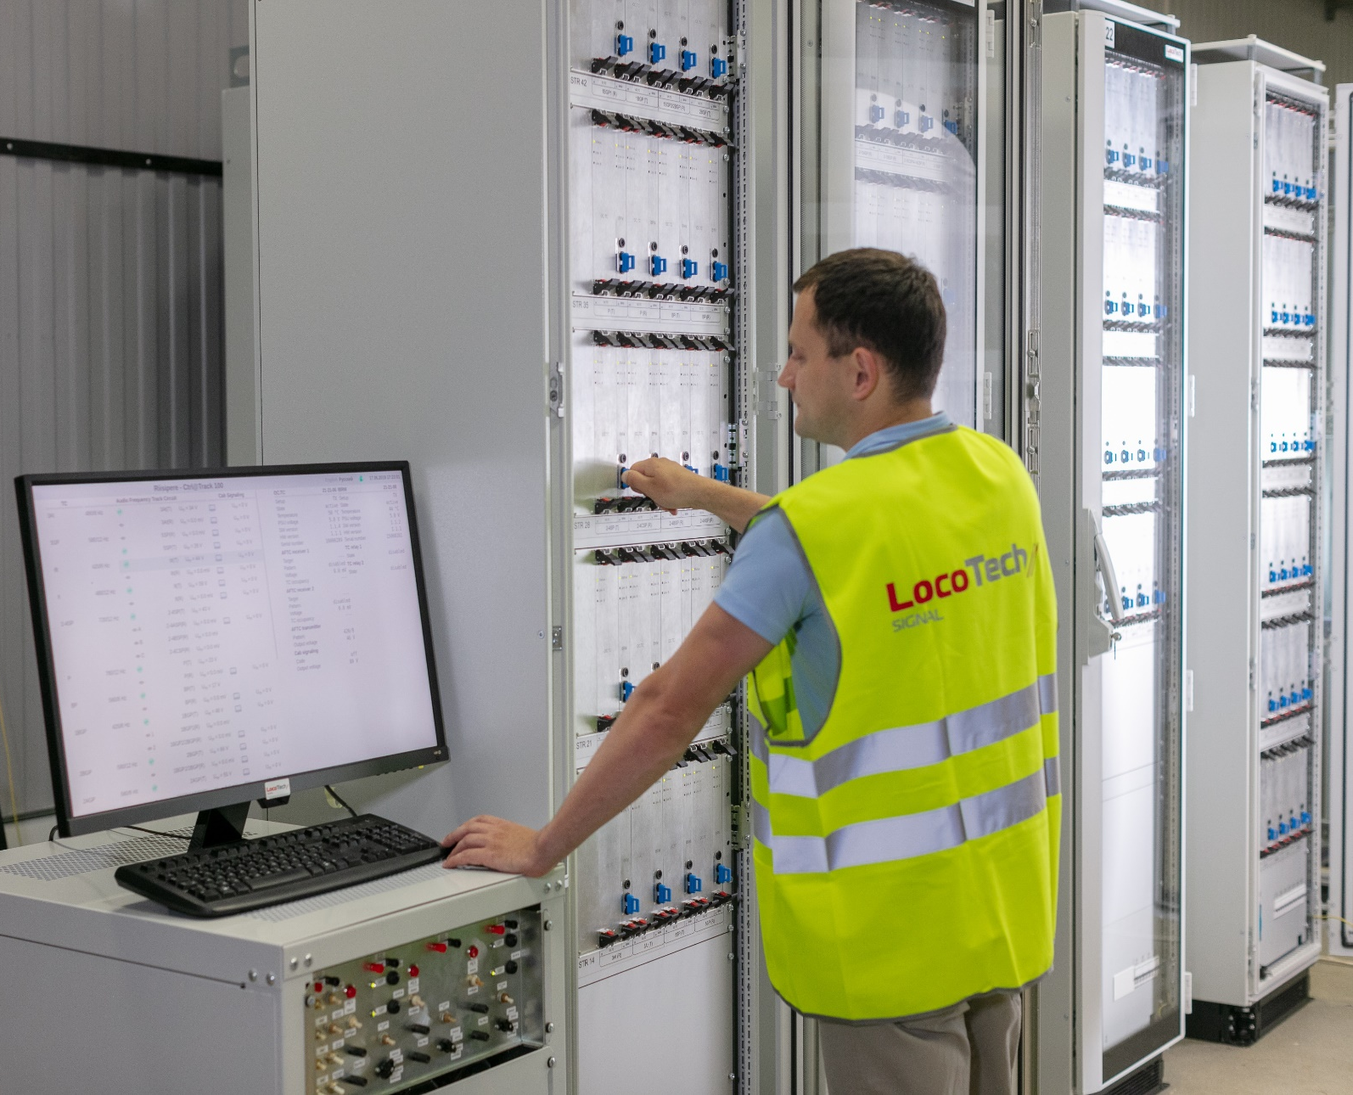
СTRL@TRACK
Computer-based Track Circuits
  Track occupancy control
  Interface with relay and computer-based interlocking systems
  Code generation for onboard ATP system
  Diagnostics of track circuits and system equipment
  System runtime logging
KEY
FUNCTIONS
  Adaptation and certification for EU and CIS markets
  Portable design
  Integration: track circuits + coding
  Ready for predictive maintenance
  (instead if routine maintenance)
  Enhanced runtime self-check functions
CUSTOMER
BENIFITS
APPLICATION
SCOPE
URBAN TRANSPORT
(INCL. METRO)
MAINLINE
TRANSPORT

Slide 15


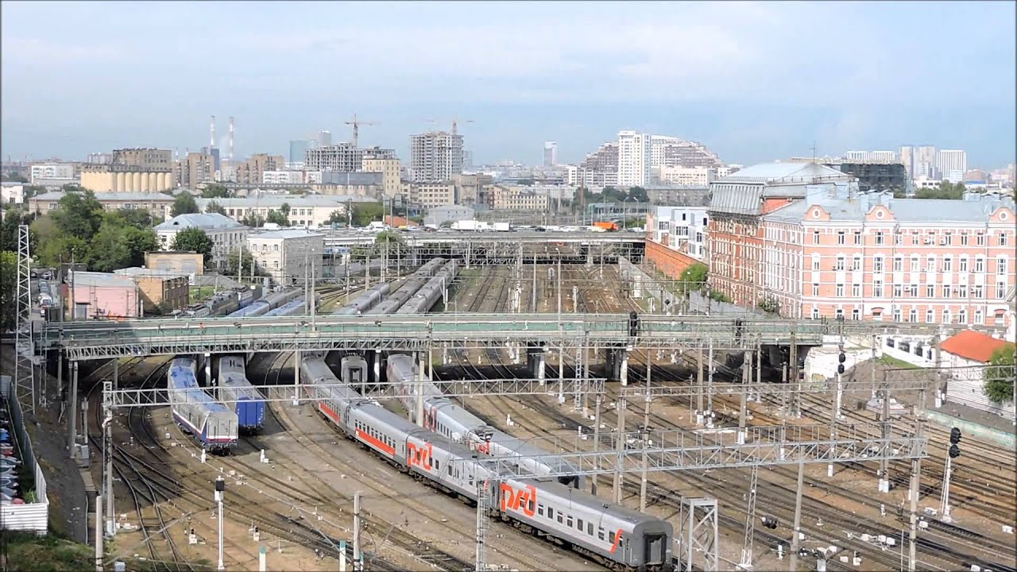
СTRL@LOCK
Computer-based Interlocking
for open lines and stations
  Automation and safe control over signaling operation at open lines and stations
  Infrastructure diagnostic
  Fixed block signaling
KEY
FUNCTIONS
In partnership with:
  Package offer
  (rolling stock, service, signaling, centralized traffic control)
  No dependency in one hardware manufacturer
  Easily configurable system for any requirements
CUSTOMER
BENIFITS
APPLICATION
SCOPE
INDUSTRIAL
TRANSPORT
URBAN TRANSPORT
(INCL. METRO)
MAINLINE
TRANSPORT

Slide 16

СTRL@TRAFFIC
Autonomous traffic
autonomous traffic control system for metro
Centralized traffic control
Automatic Train Operation
Operational control and traffic management
Traffic schedule adjustment
Online monitoring and diagnostic of rolling stock and infrastructure
KEY
FUNCTIONS
  Increase of traffic capacity without additional CAPEX*
  Elimination of traffic bottlenecks to achieve designed traffic capacity
  Energy saving at train operation
  Quick response to emergency situation and fast recovery after failures
CUSTOMER
BENIFITS
APPLICATION
SCOPE
URBAN TRANSPORT
(INCL. METRO)
INDUSTRIAL
TRANSPORT
* up to 125 thousand passengers per line (on the example of the Filevskaya line of the Moscow metro

Slide 17
LET’S TALK!
HOW TO GET IN TOUCH
ADDRESS
Moscow, 3rd Rybinskaya str. 18 bld.22
Business center «Burevestnik»
PHONE NUMBER
+7 (495) 899 0195
E-MAIL
info@locotech-signal.ru

